Slide 1
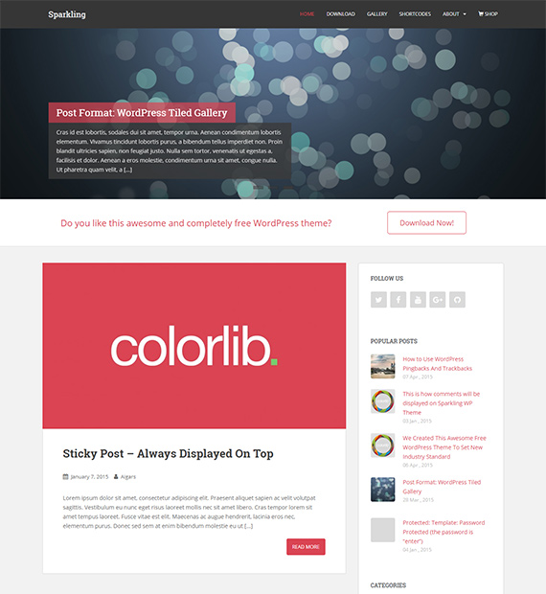
Multiple Themes(Sparkling): Unauthentic Function Injection Vulnerability.
[1]Sparkling WordPress theme is a clean, modern flat design theme developed using Bootstrap 3. The unauthenticated function injection affected <= 2.4.8 and was patched in version 2.4.9

Slide 2
Unauthentic Function Injection Vulnerability
An unauthenticated function injection vulnerability is a security flaw in a software application where an attacker can inject and execute malicious code without having to provide any form of authentication or proper authorization.
In themes, functions that handle various aspects of the site's appearance and behaviour can allow a user to inject code that gets executed with these functions and this can lead to unauthorized actions. For example, a theme that allows users to customize the site's header through a configuration panel. If the theme does not properly validate the input and an attacker can inject arbitrary code into the header configuration, they might execute functions or scripts within the context of the website, potentially leading to security compromises.
The SPARKLING THEME, along with fifteen other themes, used a version of the epsilon framework that had a serious security flaw. This flaw made it vulnerable to unauthenticated function injection. The vulnerability stemmed from a lack of proper capability and CSRF nonce checks in AJAX actions (Asynchronous JavaScript and XML actions).AJAX is a technology that allows interaction on a website without the website needing to reload each time, it loads according to a user’s input.
This feature is available to everyone, whether they're logged in or not. It enables users to assign classes, methods, and arguments, a privilege that should only be granted to administrators. However, due to a lack of capability checks and security nonces (nonces are used to validate the contents of a form to avoid malicious activity, it protects a website from Cross-Site Request Forgeries (CSRFs) attacks), this becomes a potential vulnerability. This oversight could expose the system to security threats
Because all these privileges are given to users, an attacker can pose as a user and perform a function injection attack.
The detection of this vulnerability took place in October 2019 and was subsequently reported to the authors. The matter was further escalated to the wordpress.org themes team in both March and August 2020. The issue was successfully addressed on February 9, 2022. Users were strongly recommended to promptly update their software from version 2.4.8 or earlier to the most recent version.

Slide 3
VULNERABILITY IMPACT:
Unauthenticated function injection vulnerabilities in WordPress themes can have serious consequences, which can lead to various security issues and compromise the integrity and confidentiality of a WordPress site. For Instance
An attacker may inject malicious code into the theme, leading to the manipulation of the content displayed on the website. This could include defacement, unauthorized ads, or the insertion of harmful links. For example, in terms of sending AJAX requests, an attacker can with certain arguments that repeat the target multiple times. By doing this, they can carry out an attack that amplifies its impact on the target website.
A hacker can misuse the "Requests::request multiple" method to trick a WordPress site with a security flaw. This allows them to perform a Server-Side Request Forgery (SSRF) and potentially gain access to the internal network of the site.
Unauthenticated function injection can lead to XSS vulnerabilities, allowing attackers to execute arbitrary scripts in the context of site visitors' browsers. This can lead to session hijacking, cookie theft, or other client-side attacks.
If the theme handles user input improperly, attackers could exploit unauthenticated function injection to access and expose sensitive user data stored in the WordPress database.
Depending on the server environment and the functions being exploited, attackers might escalate their privileges, execute arbitrary commands, or compromise the hosting server.
Example: In a WordPress Denial of Service (DoS) attack, the attacker can send a particular type of request using POST to "/wp-admin/admin-ajax.php." This request causes an internal loop, potentially leading to the WordPress site crashing.

Slide 4
VULNERABILITY MITIGATION:
To mitigate the impacts of unauthenticated function injection vulnerabilities in WordPress themes one can do the following:
Using proper input validation and sanitization to ensure that user input is processed securely.
Sanitization is the process of securing/cleaning/filtering input data. For example, using sanitize text field function: Example
// Get the user input from the theme options (example)
$user_input = get_theme_mod('custom_text_option');
// Sanitize the user input using sanitize_text_field
$sanitized_input = sanitize_text_field($user_input);
// Now you can use $sanitized_input safely in your theme
echo "Custom Text: " . $sanitized_input;
In this example, sanitize_text_field is used so that user input will contain only plain text with no HTML or special characters which could be used for injection attacks. Different sanitization functions would be very helpful in sanitizing data.
Regular Updating of the WordPress core, themes, and plugins to patch known vulnerabilities.
Auditing these WordPress sites for security vulnerabilities. Using security plugins or services to scan for issues.
Limiting the permissions of WordPress users and themes to the minimum necessary for their intended functionality.
Constant backup of WordPress site so that you one can quickly recover in the event of a security incident.
Following WordPress security best practices and using security plugins or services that can provide additional protection layers.
Always use existing WordPress functions when interacting with the database as they are tested for SQL injection vulnerability during the Word Press Development process.

Slide 5
References
"Epsilon Framework Themes (Various Versions) - Function Injection. "Word Defence . Accessed: date. Nov. 17,2023 [Online]. Available: URL https://www.wordfence.com/threat-intel/vulnerabilities/detail/epsilon-framework-themes-various-versions-function-injection
R. Bruandett, "Unauthenticated function injection vulnerability in WordPress Sparkling theme.Nintechnet,https://blog.nintechnet.com/unauthenticated-function-injection-vulnerability-in-wordpress-sparkling-theme/ (accessed Abbreviated Nov,18 2023).
Injection Flaws." OWASP. Accessed:Nov. 19,2023 [Online]. Available: https://owasp.org/www-community/Injection_Flaws
S. Daityari, "SQL Injection: A Detailed Guide for WordPress Users," Kinsta, https://kinsta.com/blog/sql-injection/ (accessed Nov 19,2023).
Sanitizing Data." Wordpress. Accessed: Nov. 20,2023. [Online]. Available: https://developer.wordpress.org/apis/security/sanitizing/
Exploit database. “Wordpress Epsilon Framework Multiple Themes - Unauthenticated Function Injection ”. Accessed: date. Nov. 17,2023 [Online]. Available: URL https://www.exploit-db.com/exploits/49327

